Slide 1




The Science of Communicating
Eric Duong
Northern Arizona University
Mentored by Randy Wilson

Slide 2
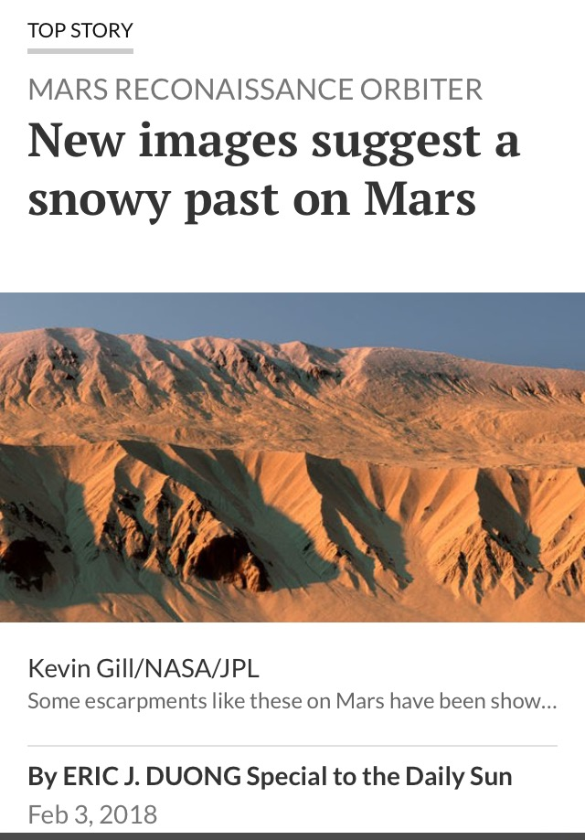
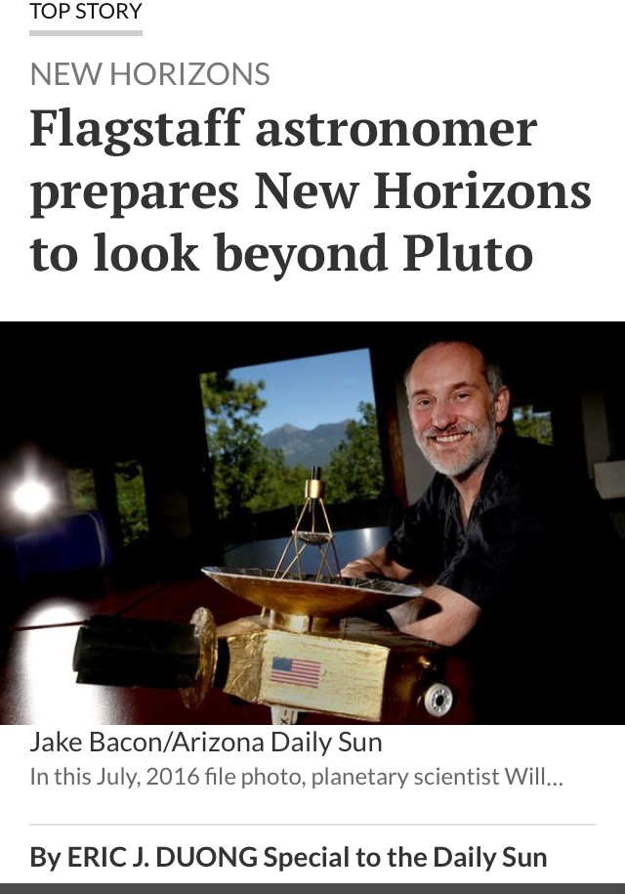
Reporting for the AZ Daily Sun

Slide 3
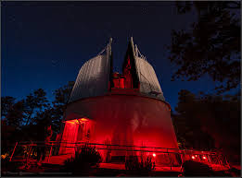
Introduction
Education and Public perception is paramount to securing research funds from the government
However, Scientists often struggle to deal with media attention effectively
Dr. Grundy, Dr. West and I created an interview training seminar to help acclimate scientists to realistic interviews

Slide 4
Project Goals
we wanted each scientist to walk away with two or three key areas where they needed to improve
Eventual goal of the project is to be renewed by the HURA grant and expand to work with USGS, students at NAU Phd programs, and Tgen North
Other options for Media Training from professionals cost upwards of $25,000
My job was to both assist these institutions and develop my own skills as a science writer

Slide 5
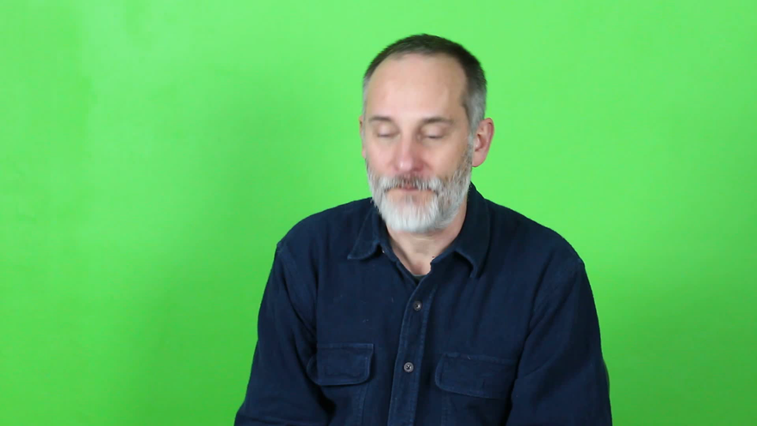
My Contributions
Every interview was reviewed by myself and the scientist’s peers after each session
In addition, press releases were created specific for the exercise and critiqued for further improvements as well
My experience with the AZ Daily Sun allowed for a realistic experience

Slide 6
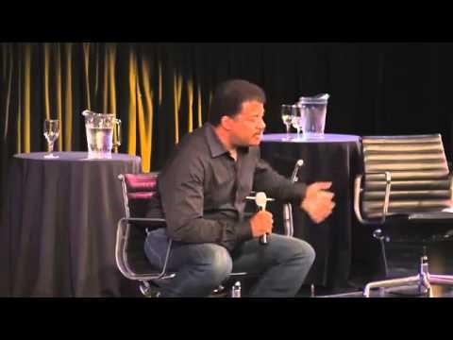
Conclusion
We found that speaking in pre-planned sound bites was the most effective skill (30 second answers or less)
Use of scientific jargon was the most evident problem
In the future, we plan to pitch this idea to the NAU Phd programs as well as USGS and Tgen North. Like any skill, repetition leads to growth.
https://www.youtube.com/watch?v=Fic_a1VfzEI&t=61s

Slide 7
Acknowledgements
Randy Wilson, AZ Daily Sun
Emery Cowan, AZ Daily Sun
Will Grundy, Lowell Observatory
Michael West, Lowell Observatory
Kathleen Stigmon, NASA Space Grant
Nadine Barlow, NASA Space Grant

Slide 8
Questions?

